Slide 1
Character Set
In C programming, a character set is the collection of valid characters that the C compiler recognizes and can be used to write programs.
1. Letters
Uppercase letters: A to Z
Lowercase letters: a to z
Used for keywords, identifiers, variables, etc.
int Age; // Uses uppercase 'A' and lowercase 'g', 'e‘
2. Digits
0 to 9
Used in numbers, constants, and as part of identifiers (but not as the first character of an identifier).
Example
int num1 = 25;

Slide 2
Character Set
3. Special Characters
Used for operations, punctuation, and program structure.
+ - * / % // Arithmetic operators
< > = ! // Relational/logical operators
; , . // Punctuation
( ) [ ] { } // Brackets and braces
4. Whitespace Characters
Space, tab (\t), newline (\n), carriage return, form feed
Used to separate tokens and improve readability.
Example:
int a = 5; // Space after 'int' and around '='
5. Escape Sequences
Special characters represented with a backslash \.
\n // Newline
\t // Horizontal tab
\\ // Backslash
" // Double quote
' // Single quote

Slide 3
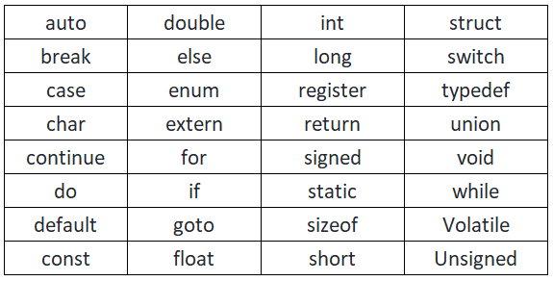
Keywords in C
Keywords are predefined, reserved words in C.
Cannot be used as identifiers (variable/function names).
Written in lowercase only.
C has 32 standard keywords

Slide 4
C Identifiers
Identifier refers to name given to entities such as variables, functions, structures etc.
Identifiers must be unique.
They are created to give a unique name to an entity to identify it during the execution of the program.
int money;
double accountBalance;
Here, money and accountBalance are identifiers.
Also, identifier names must be different from keywords. You cannot use int as an identifier because int is a keyword.
Rules for naming identifiers
A valid identifier can have letters (both uppercase and lowercase letters), digits and underscores.
The first letter of an identifier should be either a letter or an underscore.
You cannot use keywords like int, while etc. as identifiers.
There is no rule on how long an identifier can be. However, you may run into problems in some compilers if the identifier is longer than 31 characters.

Slide 5
C Tokens
In C, tokens are the smallest units of a program that have meaning to the compiler.
When you write code, the compiler breaks it into tokens for understanding.
Types of Tokens in C:
Keywords – Reserved words with special meaning.
Identifiers – Names given to variables, functions, etc.
Constants – Fixed values (like 10, 3.14, 'A').
Strings – Sequence of characters inside double quotes ("Hello").
Operators – Symbols for operations (+, -, *, /, &&, ==).
Special Symbols – Punctuation & delimiters (;, {}, [], ()).

Slide 6
C Tokens
int num = 10;
int → keyword
num → identifier
= → operator
10 → constant
; → special symbol
Practice
#include <stdio.h> // Preprocessor directive
int main() {
int num = 10; // Variable initialization
float price = 99.5;
printf("Number: %d\n", num);
printf("Price: %.2f\n", price);
}

Slide 7
Token | Type of Token
#include | Preprocessor directive
<stdio.h> | Header file name
int | Keyword
main | Identifier
( ) | Special symbols
{ } | Special symbols
num | Identifier
= | Operator
10 | Constant
; | Special symbol
float | Keyword
price | Identifier
99.5 | Constant
printf | Identifier
"Number: %d\n" | String constant

Slide 8
Variables
A variable in C is a named memory location used to store data.
Its value can change during program execution.
It must be declared before use.
Syntax:
data_type variable_name;
int age;
float marks;
char grade;
2. Initialization of Variables
int age = 20;
float pi = 3.14;
char grade = 'A';

Slide 9
Variables - Rules for Naming Variables
1. Must start with a letter or underscore (_).
(✅ age, _count | ❌ 1number)
2. Can contain letters, digits, and underscore.
3. No spaces or special characters.
(❌ total marks, ✅ total_marks)
4. Cannot be a C keyword.
(❌ int float;)
5. Case-sensitive (Age and age are different).

Slide 10
Types of Variables in C
Based on scope
(a) Local Variables
Declared inside a function or block.
Accessible only within that block.
(b) Global Variables
Declared outside all functions.
Accessible from any function.
#include <stdio.h>
int y = 20; // global variable
int main() {
printf("y = %d", y);
return 0;
}
#include <stdio.h>
int main() {
int x = 10; // local variable
printf("x = %d", x);
return 0;
}

Slide 11
Constants in C
When you declare a constant variable, it must be assigned with a value
const int MAX_VALUE = 100;
const float PI = 3.14159;
How not to use constant
const int myNum = 15; // myNum will always be 15
myNum = 10; // error: assignment of read-only variable 'myNum’
const int minutesPerHour;
minutesPerHour = 60; // error

Slide 12
Defining symbolic constants
In C programming, a symbolic constant is a name that represents a constant value.
Instead of writing a number or value directly in the program, we give it a meaningful name.
This improves readability, maintainability, and reduces errors if the value needs to be changed later
Syntax
#define NAME value
#include <stdio.h>
#define PI 3.14159
#define MAX 100
int main() {
float area, radius = 5;
area = PI * radius * radius; // PI is replaced by 3.14159
printf("Area of Circle = %f \n", area);
printf("Maximum Limit = %d \n", MAX);
return 0; }

Slide 13
Input and output with C - Formatted I/O Functions
1. printf()
These functions are part of <stdio.h> library.
printf() – Output function
Used to display data (text, numbers, characters, etc.) on the screen.
Example : printf("control string", variable1, variable2, ...);
2.scanf()
scanf() – Input function
Used to take input from user.
scanf("control string", &variable1, &variable2, ...);

Slide 14
Control Strings and Escape Sequences
Control strings = "format specifiers + escape sequences" used in printf/scanf.
Control string contains format specifiers (like %d, %f, %c, %s, %lf, %x) and escape sequences.
Escape sequences are special character combinations starting with \.
Escape Sequence | Meaning
\n | New line
\t | Horizontal tab
\b | Backspace
\\ | Backslash (\)
\" | Double quote (")
\' | Single quote (')
#include <stdio.h>
int main() {
printf("Hello\nWorld\n"); // newline
printf("A\tB\tC\n"); // tab space
printf("He said, \"Hi!\"\n"); // quotes
return 0;
}

Slide 15
We can also control width & precision:
%5d → prints an integer in 5 spaces
%.2f → prints float with 2 decimal places
Output
Hello
World
A B C
He said, "Hi!“

Slide 16
Unformatted I/O Functions
Unlike printf/scanf, unformatted functions deal with single character or string input/output.
(a) getchar()
Reads a single character from keyboard.
#include <stdio.h>
int main() {
char ch;
printf("Enter a character: ");
ch = getchar(); // reads single character
printf("You entered: %c\n", ch);
return 0;
}
(b) putchar()
Prints a single character on screen.
#include <stdio.h>
int main() {
char ch = 'A';
putchar(ch); // prints A
putchar('\n'); // newline
return 0;
}

Slide 17
Unformatted I/O Functions
3. puts()
Prints a string followed by a newline.
#include <stdio.h>
int main() {
char name[] = “NIPE";
puts(name); // prints string
return 0;
}

Slide 18
Operators
An operator performs a certain operation on operands. An operator needs one or more operands for the operation to be performed.
There are 3 types of operators in C
Unary operators
Binary operators
Ternary operators
Unary operators
In this type, the operates executes only with single operand
Ex:- ++, --

Slide 19
Binary operators
Binary operator is an operator that requires two operands to perform an operation and produce a result.
Types of Binary operators
Arithmetic Operators
Relational Operators
Logical Operators
Bitwise Operators
Assignment Operators

Slide 20
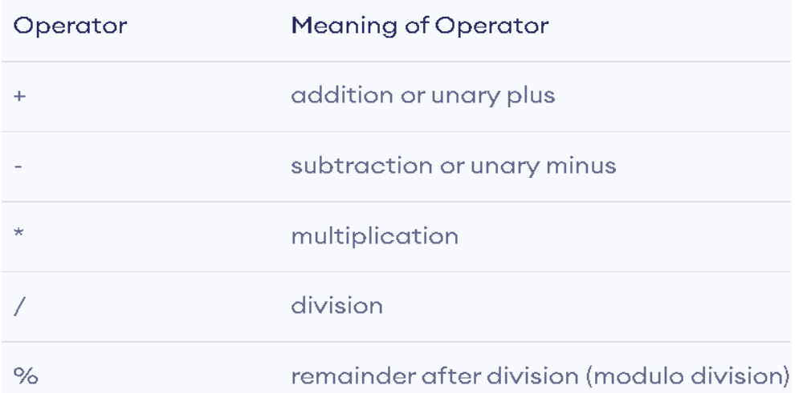
Binary operators - Arithmetic Operators
Arithmetic operators (+, -, *, /, %). These operators perform mathematical calculations on numerical data such as addition, subtraction, multiplication, division, and finding the remainder.

Slide 21
Binary operators - Arithmetic Operators
Operator | Description | Example | Result if a = 10, b = 3
+ | Addition | a + b | 13
- | Subtraction | a - b | 7
* | Multiplication | a * b | 30
/ | Division (quotient) | a / b | 3 (integer division)
% | Modulus (remainder) | a % b | 1

Slide 22
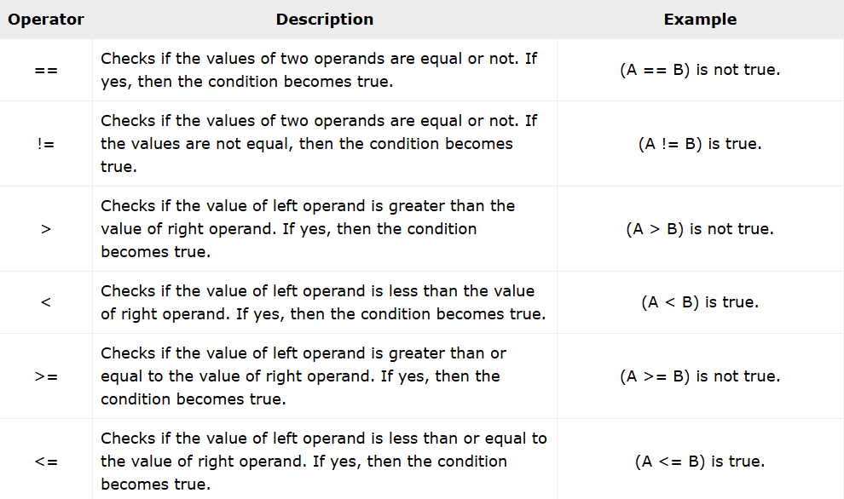
Binary operators - Relational Operators
Relational operators/Comparison operators in C are commonly used to check the relationship between the two variables.
These operators are used to compare two operands and return a boolean value (true or false). They are used in a boolean expression.

Slide 23
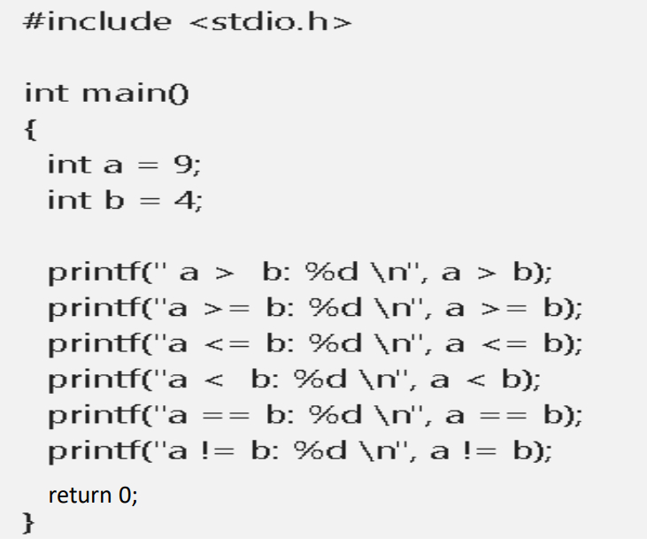
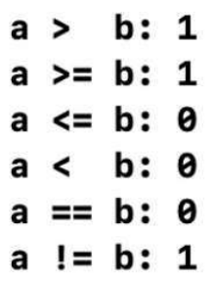
Binary operators - Relational Operators(Comparision Operators)
output

Slide 24
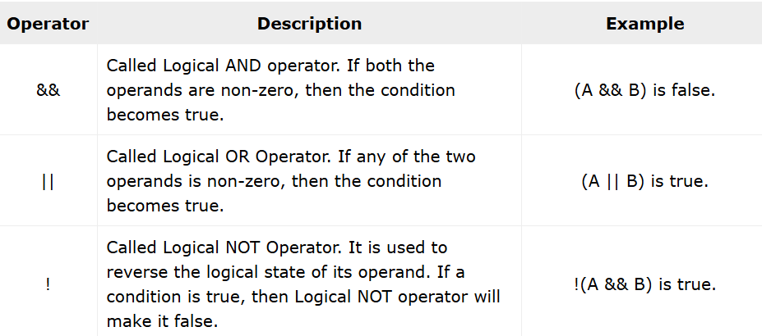
Binary operators – Logical operators
These operators are used to combine two or more boolean expressions. We can form a compound Boolean expression by combining Boolean expression with these operators.

Slide 25
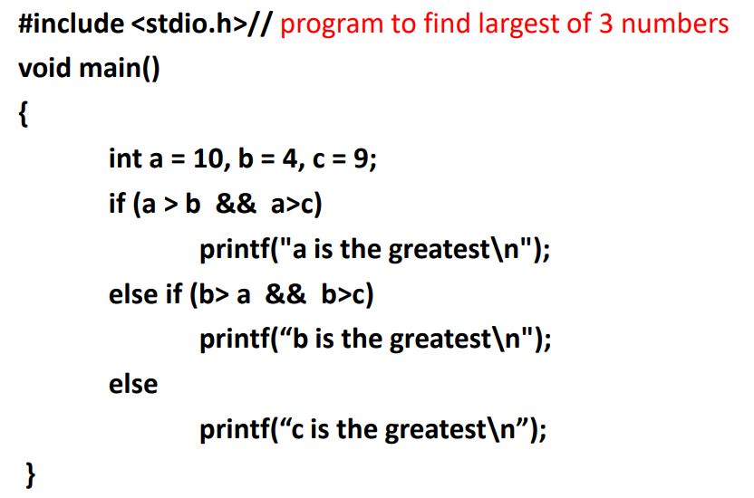
Binary operators – Logical operators

Slide 26
Binary operators - Assignment operators
In C, assignment operators are used to assign values to variables. The basic assignment operator is =, and there are also compound assignment operators that combine an arithmetic operation with assignment.
Operator | Description | Example | Equivalent To
= | Assign | a = b; | —
+= | Add and assign | a += b; | a = a + b;
-= | Subtract and assign | a -= b; | a = a - b;
*= | Multiply and assign | a *= b; | a = a * b;
/= | Divide and assign | a /= b; | a = a / b;
%= | Modulus and assign | a %= b; | a = a % b;

Slide 27
Binary operators - Assignment operators
#include <stdio.h>
int main() {
int a = 10, b = 5;
printf("Initial value of a: %d\n", a);
a += b; // a = a + b
printf("After a += b: %d\n", a);
a *= 2; // a = a * 2
printf("After a *= 2: %d\n", a);
a -= 5; // a = a - 5
printf("After a -= 5: %d\n", a);
a /= 2; // a = a / 2
printf("After a /= 2: %d\n", a);
return 0;
}

Slide 28
Bitwise Operators
Bitwise operators perform operations bit by bit on integers (binary representation).
They work faster and directly manipulate the bits (0s and 1s) of a number.
Operator | Name | Description | Example
& | AND | Sets each bit to 1 if both bits are 1 | (A & B)
| | OR | OR | (A | B)
^ | XOR (Exclusive) | Sets each bit to 1 if only one of the bits is 1 (not both) | (A ^ B)
~ | NOT (1's comp) | Inverts all bits (1 becomes 0, 0 becomes 1) | ~A
<< | Left Shift | Shifts bits to the left, fills with 0s | A << 2
>> | Right Shift | Shifts bits to the right, fills with 0s (for unsigned numbers) | A >> 2
&: both bits must be 1.
|: either bit must be 1.
^: exactly one bit is 1.
~: flips all bits.
<<: multiply by 2 for each shift.
>>: divide by 2 for each shift.

Slide 29
Bitwise Operators - &
a = 5 (binary: 0101)
b = 3 (binary: 0011)
0101 (5)
0011 (3)
----
0001 = 1
a & b = 1
#include <stdio.h>
int main() {
int a = 5, b = 3;
printf("a & b = %d\n", a & b);
return 0;
}

Slide 30
Bitwise Operators | , ^ (OR,XOR)
printf("a | b = %d\n", a | b);
Binary
0101 (5)
0011 (3)
---
0111 = 7
a | b = 7
printf("a ^ b = %d\n", a ^ b);
Binary
0101 (5)
0011 (3)
---
0110 = 6
a ^ b = 6

Slide 31
Bitwise Operators
printf("a << 1 = %d\n", a << 1);
Binary
0101 << 1 = 1010 = 10
a << 1 = 10
printf("a >> 1 = %d\n", a >> 1);
Binary
0101 >> 1 = 0010 = 2
a >> 1 = 2

Slide 32
Ternary Operator - ?
The ternary operator (?:) in C is a type of conditional operator. The term "ternary" implies that the operator has three operands.
The ternary operator is often used to put multiple conditional (if-else) statements in a more compact manner.
Syntax of Ternary Operator in C
condition ? exp2 : exp3
It uses three operands −
condition − A Boolean expression evaluating to true or false
exp2 − Returned by the ? operator when exp1 is true
exp3 − Returned by the ? operator when exp1 is false

Slide 33
Ternary Operator - ?
#include <stdio.h>
int main()
{
int a = 10;
(a % 2 == 0) ? printf("%d is Even \n", a) : printf("%d is Odd \n", a);
return 0;
}

Slide 34
Decision-making statements (Conditional statements)
In C programming, decision-making statements are used to control the flow of execution based on certain conditions.
These statements allow the program to make choices and execute different blocks of code depending on whether a condition is true or false.
We use the following keywords and operators in the decision-making statements of a C program − if, else, switch, case, default, goto, the ?: operator, break, and continue statements.

Slide 35
Decision-making statements (Conditional statements)
Statement | Syntax Overview | Description | Use Case Example
if | if (condition) { ... } | Executes a block only if the condition is true | Check if a number is positive
if-else | if (condition) { ... } else { ... } | Chooses between two paths based on a condition | Check if a number is even or odd
if-else if (ladder) | if (c1) {...} else if (c2) {...} else { ... } | Evaluates multiple conditions in sequence; executes the first true one | Grading system based on marks
nested if | if (c1) { I f (c2) { ... } } | An if statement inside another if; used for dependent decisions | Login: Check username, then password
switch | switch(expr) { case v1: ... break; ... default: ... } | Compares a variable to multiple constant values; more efficient than many if-else blocks | Day of week, menu selection

Slide 36
If Statement
Executes a block of code only if the condition is true.
Syntax:
if (condition) {
// code to execute if condition is true
}
Example:
int age = 20;
if (age >= 18) {
printf("You are eligible to vote.\n");
}

Slide 37
if...else statement
Executes one block if the condition is true, otherwise executes another block.
Syntax:
if (condition)
{
// code if condition is true
} else
{
// code if condition is false
}
Example:
int number = 5;
if (number % 2 == 0)
{
printf("Even number\n");
}
else
{
printf("Odd number\n");
}

Slide 38
if...else if...
if...else if...else ladder is used to evaluate multiple conditions sequentially.
As soon as one condition is true, its corresponding block of code is executed, and the rest are skipped.
Syntax
if (condition1) {
// block of code if condition1 is true
} else if (condition2) {
// block of code if condition2 is true
} else if (condition3) {
// block of code if condition3 is true
} else {
// block of code if none of the above conditions are true
}

Slide 39
if...else if...
#include <stdio.h>
int main() {
int marks = 78;
if (marks >= 90) {
printf("Grade A\n");
} else if (marks >= 75) {
printf("Grade B\n");
} else if (marks >= 60) {
printf("Grade C\n");
} else if (marks >= 40) {
printf("Grade D\n");
} else {
printf("Fail\n");
}
return 0;
}

Slide 40
nested if
A nested if means placing one if (or if-else) inside another if or else block.
if (conditionA) {
// A is true
if (conditionB) {
// B is true (given A already true)
} else {
// B is false (given A already true)
}
} else {
// A is false
}
Evaluate outer condition
if false, skip its whole block.
If true, enter block and evaluate the inner condition.
The inner test only runs if the outer test passed (or failed, depending on where you nest it).

Slide 41
Nested if
#include <stdio.h>
int main() {
int number;
printf("Enter a number: ");
scanf("%d", &number);
if (number > 0) {
// First condition: positive number
if (number % 2 == 0) {
printf("The number is positive and even.\n");
} else {
printf("The number is positive but odd.\n");
}
} else {
printf("The number is not positive.\n");
}
return 0;
}

Slide 42
Largest of 3 numbers
#include <stdio.h>
int main() {
int a, b, c;
printf("Enter three numbers: ");
scanf("%d %d %d", &a, &b, &c);
if (a > b) {
if (a > c) {
printf("The largest number is %d\n", a);
} else {
printf("The largest number is %d\n", c);
}
} else {
if (b > c) {
printf("The largest number is %d\n", b);
} else {
printf("The largest number is %d\n", c);
}
}
return 0;
}

Slide 43
Scenario:
In a school athletics competition, three students — John, Meena, and Arjun — participated in a 100-meter race. The time (in seconds) each took to complete the race is recorded. Write a program to determine who was not the fastest (i.e., who took the longest time).

Slide 44
Switch statement
Used when you want to compare a variable against multiple values (cases).
Syntax
switch (expression) {
case value1:
// code
break;
case value2:
// code
break;
...
default:
// default code
}

Slide 45
Switch statement
#include <stdio.h>
int main() {
char grade = 'B';
switch (grade) {
case 'A':
printf("Excellent!\n");
break;
case 'B':
printf("Good!\n");
break;
case 'C':
printf("Fair!\n");
break;
default:
printf("Invalid grade\n");
}
return 0;
}

Slide 46
Switch statement
#include <stdio.h>
int main() {
char op = '*';
int a = 5, b = 3;
switch (op) {
case '+': printf("Sum: %d\n", a + b); break;
case '-': printf("Difference: %d\n", a - b); break;
case '*': printf("Product: %d\n", a * b); break;
case '/': printf("Quotient: %d\n", a / b); break;
default: printf("Invalid operator\n");
}
return 0;
}
Use switch when checking a single variable against many constant values.
Use if-else ladder when you need to check ranges, relational conditions, or multiple variables.

Slide 47
C – Loops / Iterative Statements
In C programming, loops are used to execute a block of code repeatedly as long as a certain condition is true.
Loops help reduce code redundancy and make programs more efficient and readable.
Types of Loops in C
C provides three types of looping statements:
while loop
do-while loop
for loop

Slide 48
#include <stdio.h>
int main (){
int a = 1;
printf("a: %d\n", a);
a++;
printf("a: %d\n", a);
a++;
}
printf("a: %d\n", a);
a++;
printf("a: %d\n", a);
a++;
printf("a: %d\n", a);
return 0;

Slide 49
Types of loops
while loop
Repeats a statement or group of statements while a given condition is true. It tests the condition before executing the loop body.
while (condition) {
// Code to execute
Increment or decrement operators
}
It checks the condition before executing the loop body.
If the condition is false initially, the loop may never run.

Slide 50
while loop
//Program to print 5 natural numbers
#include <stdio.h>
int main() {
int i = 1;
while (i <= 5) {
printf("Count: %d\n", i);
i++;
}
return 0;
}

Slide 51
while loop
Sum of first N natural numbers
#include <stdio.h>
int main() {
int n, i = 1, sum = 0;
printf("Enter a number: ");
scanf("%d", &n);
while(i <= n) {
sum += i;
i++;
}
printf("Sum = %d", sum);
return 0;
}

Slide 52
for Loop in C
for Loop in C is a control structure used to execute a block of code repeatedly for a specified number of times.
The basic syntax is:
for (initialization; condition; increment/decrement) {
// code to be executed
}
Initialization: The initialization part is executed only once, and is usually used to initialize the loop counter variable.
Condition: The condition is evaluated before each iteration. If it evaluates to true, the loop continues. If it evaluates to false, the loop ends.
Increment/Decrement: The increment/decrement part is executed after each iteration, and is used to update the loop counter variable.

Slide 53
for Loop in C
#include <stdio.h>
int main() {
int i;
for (i = 0; i < 5; i++) {
printf("%d\n", i);
}
return 0;
}
Output
0
1
2
3
4

Slide 54
do-while loop
do-while Loop in C is a control structure used to execute a block of code repeatedly for a specified number of times
The basic syntax is:
do {
// code to be executed
} while (condition);
Code to be executed: The code inside the loop is executed at least once, regardless of the condition.
Condition: The condition is evaluated after each iteration. If it evaluates to true, the loop continues. If it evaluates to false, the loop ends.
The key difference between the For Loop and the Do-While Loop is that the Do-While Loop executes the code at least once before checking the condition
whereas the For Loop checks the condition before executing the code.

Slide 55
do-while loop
#include <stdio.h>
int main() {
int i = 0;
do {
printf("%d\n", i);
i++;
} while (i < 5);
return 0;
}
Output
0
1
2
3
4

Slide 56
Loops – Example code
#include <stdio.h>
int main() {
int i = 1;
while (i <= 10) {
printf("5 x %d = %d\n", i, 5 * i);
i++;
}
return 0;
}
#include <stdio.h>
int main() {
int i = 1;
do {
printf("5 x %d = %d\n", i, 5 * i);
i++;
} while (i <= 10);
return 0;
}
#include <stdio.h>
int main() {
int i;
for (i = 1; i <= 10; i++) {
printf("5 x %d = %d\n", i, 5 * i);
}
return 0;
}

Slide 57
break
break is used to terminate the loop prematurely.
Works in for, while, and do-while loops.
Also used in switch-case statements.
#include <stdio.h>
int main()
int i;
for (i = 0; i < 10; i++) {
if (i == 4) {
break;
}
printf("%d\n", i);
}

Slide 58
break
Stop printing when number is divisible by 7
#include <stdio.h>
int main() {
int i;
for (i = 1; i <= 20; i++) {
if (i % 7 == 0) {
printf("Found a number divisible by 7: %d. Breaking the loop.\n", i);
break;
}
printf("Number: %d\n", i);
}
return 0;
}

Slide 59
Continue Statement
The continue statement breaks one iteration (in the loop), if a specified condition occurs, and continues with the next iteration in the loop.
#include <stdio.h>
int main()
int i;
for (i = 0; i < 10; i++) {
if (i == 6) {
continue;
}
printf("%d\n", i);
}
skips the value of 6
Output
0 1 2 3
4 5 7 8 9

Slide 60
Continue Statement – with while loop
#include <stdio.h>
int main() {
int i ;
while (i < 10) {
if (i == 6) {
i++;
continue;
}
printf("%d\n", i);
i++;
}
return 0;
}

Slide 61
Practice Programs
Write a program in C to print numbers from 1 to 10 using all 3 types of loops.
Write a program in C Print even numbers from 1 to 50.
Write a program in C Print numbers from 10 to 1 (reverse order).
Write a program in C Print squares of first 10 natural numbers.
Write a program in C Take input until user enters a positive number.
Write a program in C Print the sum of odd numbers between 1 and 20.

